Slide 1
OLAP
On-Line Analytical Processing

Slide 2
What is OLAP?
OLAP is computer processing that enables a user to easily and selectively extract and view data from different points of view.
OLAP is actually a multidimensional database which considers each data attribute (such as product, geographic sales region, and time period) as a separate "dimension". OLAP software can locate the intersection of dimensions (all products sold in the Eastern region above a certain price during a certain time period) and display them. Attributes such as time periods can be broken down into sub attributes.
For example, a user can request that data be analyzed to display a spreadsheet showing all of a company's beach ball products sold in Florida in the month of July, compare revenue figures with those for the same products in September, and then see a comparison of other product sales in Florida in the same time period. To facilitate this kind of analysis, OLAP data is stored in a multidimensional database.

Slide 3


Let’s play cube!!??

Slide 4
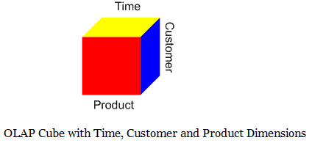

Slide 5
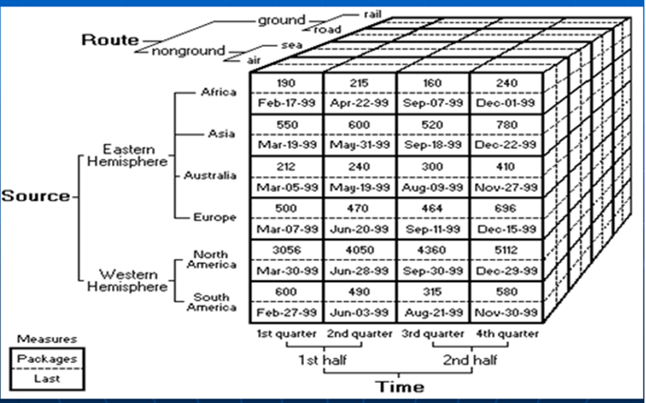
A complete Cube

Slide 6
Table vs Cube
A simplified example:
A typical relational table
Make it into a cube
Data are organized by rows
Data are organized by intersections
Sales table
Region dim
Product | Region | Sales $
Donut | East | 1
Donut | West | 2
Milk | East | 3
Milk | West | 4
 | East | West | Total
Donut | 1 | 2 | 3
Milk | 3 | 4 | 7
Total | 4 | 6 | 10
Product dim
Notes:
6
A simple example:
A Sales table contain “Product” column, “Region” column, and “Sales $” column. The data are organized by rows.
If we turn the relational table into a cube, the Product becomes the Product dimension, the Region becomes Region dimension, and the Sales $ is becomes a measure of the cube.

Slide 7
OLAP
Country
France
Time
January
Canada
Australia
Australia
February
February
March
$6,745
April
“For Australia, show me the Sales for February”
May
Sales
Budget
Sales
Qty
Cost
Notes:
One question might ask to show Margin for the February for Beef Stew. When ever you try to answer a question, try to break down the question piece by piece instead of trying to answer the entire question. This will make it easier. First select Beef Stew from Products. This selects a slice of the cube. Next, select Margin from the Measures. Finally, select February for Time.
The result is one intersection in the cube which totals $6,745.

Slide 8
A Sample Data Cube
Time
Total annual sales
of TV in U.S.A.
1Qtr
2Qtr
3Qtr
4Qtr
sum
TV
Item
PC
U.S.A
VCR
sum
Canada
Location
Mexico
sum
All, All, All

Slide 9
OLAP for a Business Man --
For people on the business side, the key feature within interrelated data is "Multidimensional." In other words, the ability to analyze metrics in different dimensions such as time, geography, gender, product, etc.
For example, sales for the company is up.
Which region is most responsible for this increase?
Which store in this region is most responsible for the increase?
What particular product category or categories contributed the most to the increase?
Answering these types of questions, in order, means that you are performing an OLAP analysis.

Slide 10
Comparing with Relational Database
Compared to a relational database, OLAP adds
data scalability
– automatic aggregations
– dimension management
calculation complexity
– ratios and family relationships (percent of total, percent of parent)
– time series calculations (period over period growth)

Slide 11
Comparing with Spread Sheets
Compared to a spreadsheet, OLAP adds
data scalability
– centralized management
calculation complexity
– multiple dimensions
– family relationships

Slide 12
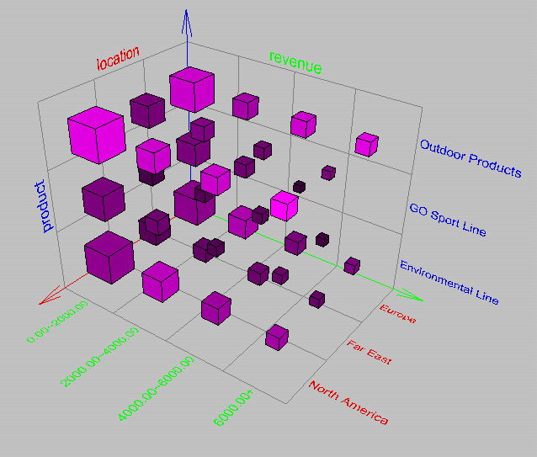
Browsing a Data Cube
Visualization
OLAP capabilities
Interactive manipulation

Slide 13
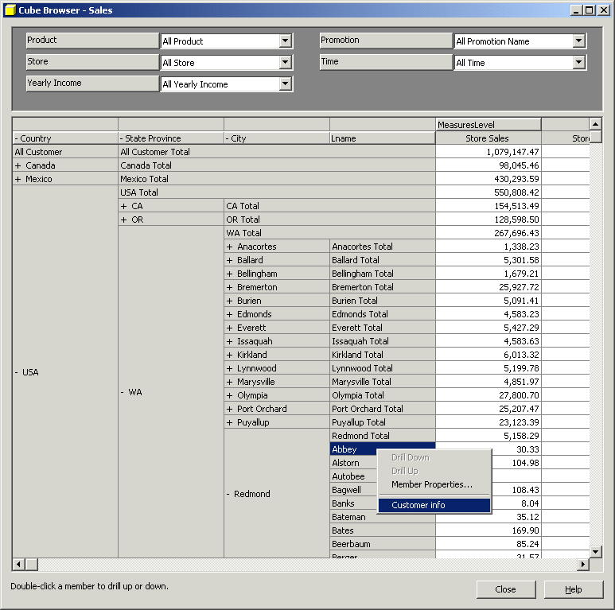
Sample OLAP Drill down online report

Slide 14
Major vendors of OLAP
Oracle -- Essbase (Hyperion)
OBIEE
SAS
Microstrategy
Business Objects
Microsoft – SSAS
And many more…..

